Slide 1



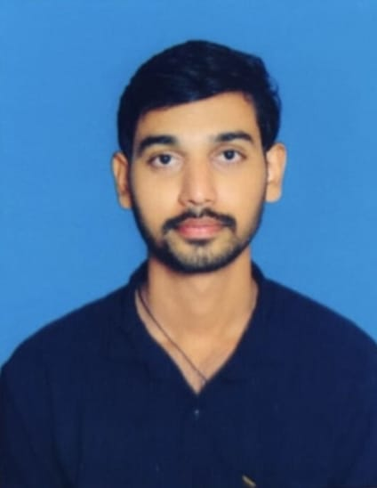
STUDENT DETAILS
Name : Pavan kumar deekshith velchuri
Skills Build Email ID: 20ne1a04g5@gamil.com
College Name: Tirumala Engineering College
College State: Andhra Pradesh
Internship Domain : FRONT END DEVELOPMENT (FED B1)
Internship Start and End Date : 5th June 2023 to 3rd July 2023

Slide 2
PROJECT TITLE / PROBLEM STATEMENT
“PORTFOLIO”
Web Developers/Designers and UI/UX Developers Often have PORTFOLIO websites which help them to show case their work with general Public.

Slide 3
AGENDA
INTRODUCTION
01
SERVICES
02
SKILLS
03
CERTIFICATIONS

Slide 4
PROJECT OVERVIEW
PURPOSE : A PORTFOLIO IS A LIVING AND CHANGING COLLECTION OF RECORDS THAT REFLECT YOUR ACCOMPLISHMENTS ,SKILLS AND EXPERIENCES.
OBJECTIVE : ENCOURAGES STUDENT REFLECTION ON THEIR LEARNING.

Slide 5

WHO ARE THE END USERS OF THE PROJECT?
STUDENTS
DEVELOPERS
CLIENTS
STAKE HOLDERS
RECRUITERS

Slide 6
YOUR SOLUTION & ITS VALUE PREPOSITION
A SOLUTION OF PORTFOLIO DESCRIBES THE RELATIONSHIPS AMONG IMPLEMENTED SOLUTIONS OF A PARTICULAR TYPE IN ORDER TO COORDINATE CHANGE ACROSS THOSE SOLUTIONS.

Slide 7
HOW DO YOU CUSTOMIZE YOUR PROJECT
BY USING THE WEBSITE BOOTSTRAP AND ALSO REFERD THE TEXT BOOXS,I CUSTOMIZED MY PROJECT.

Slide 8

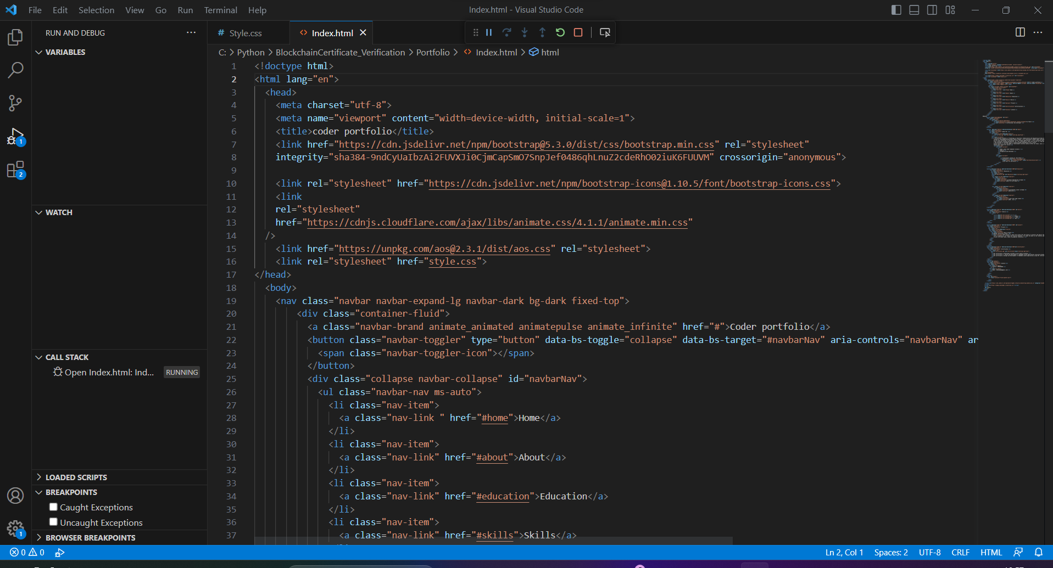
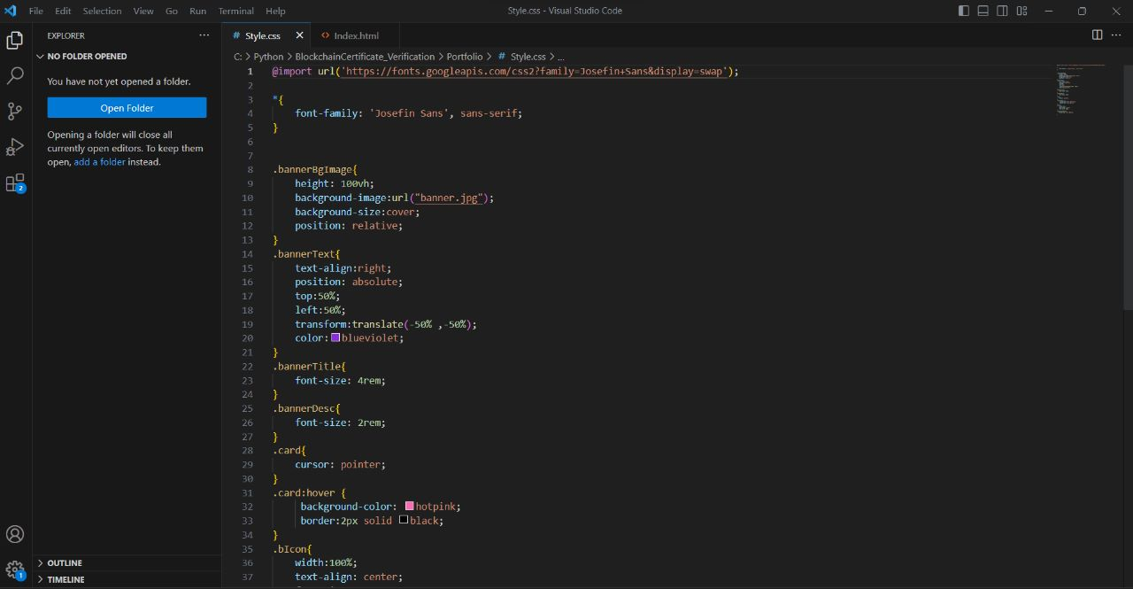
MODELLING
A STANDARD MODELLING PORTFOLIO SHOULD CONTAIN SEVERAL TEXTS AND IMAGES.

Slide 9
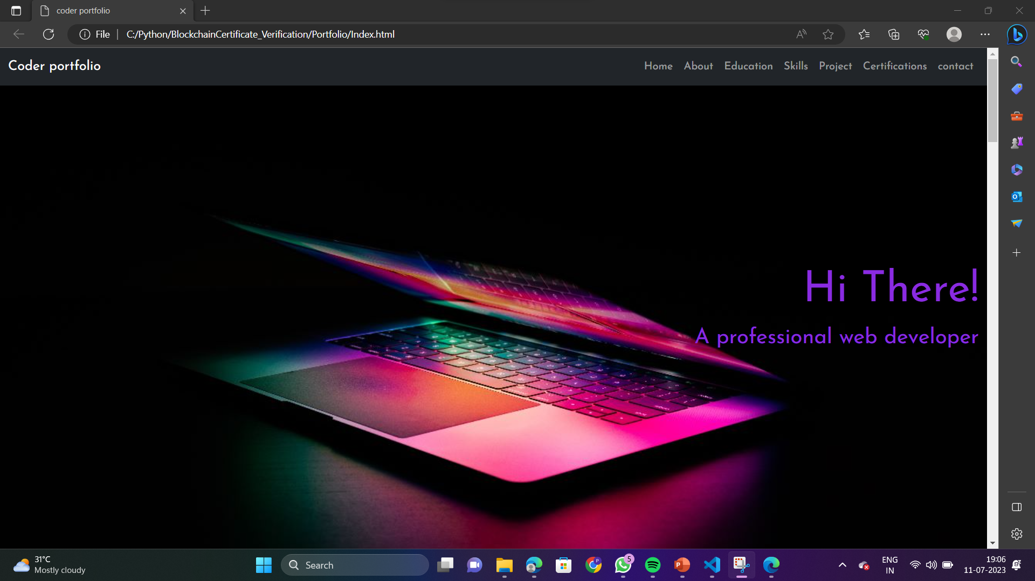
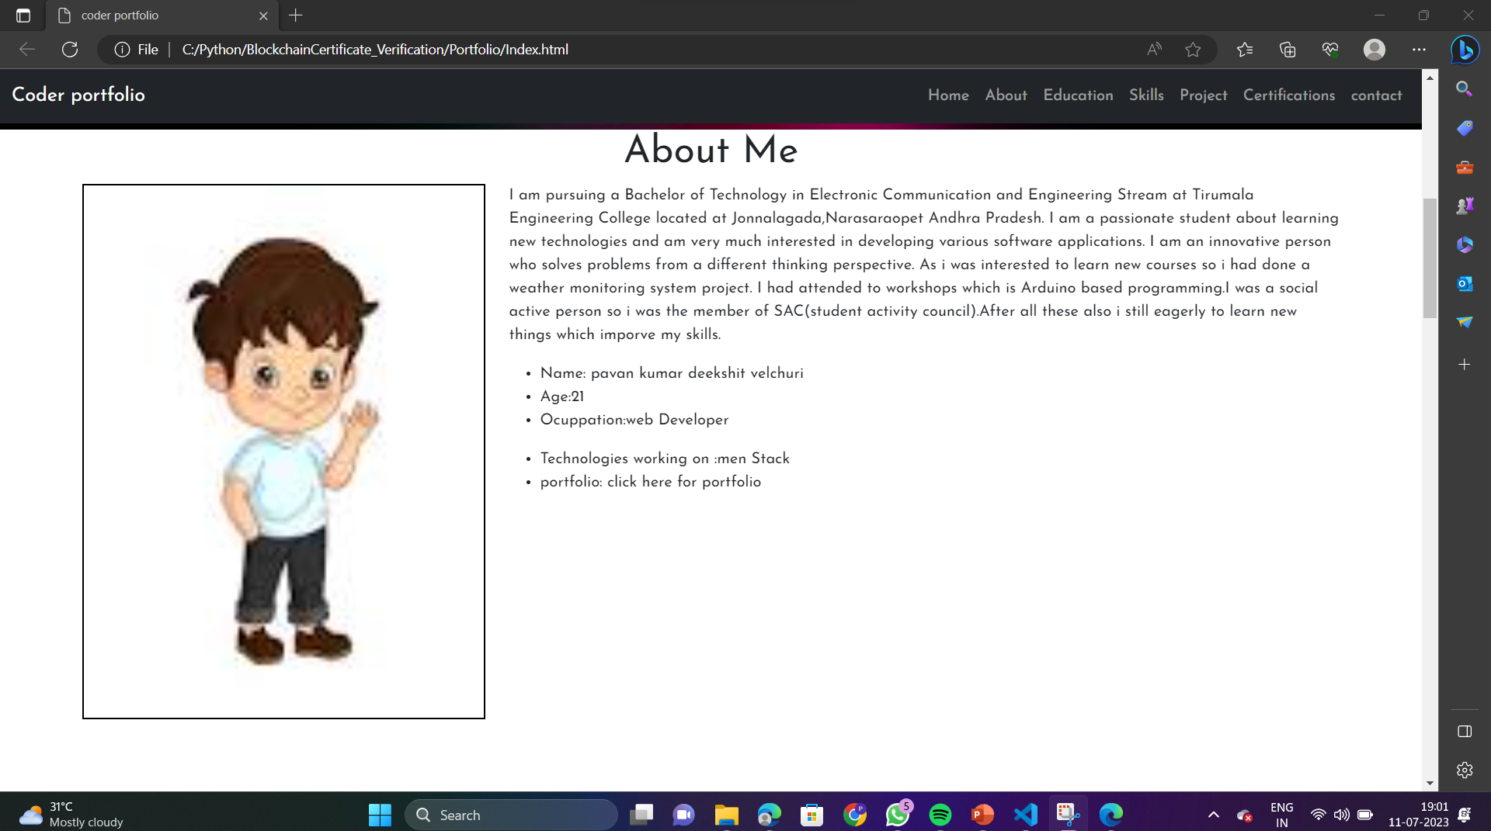
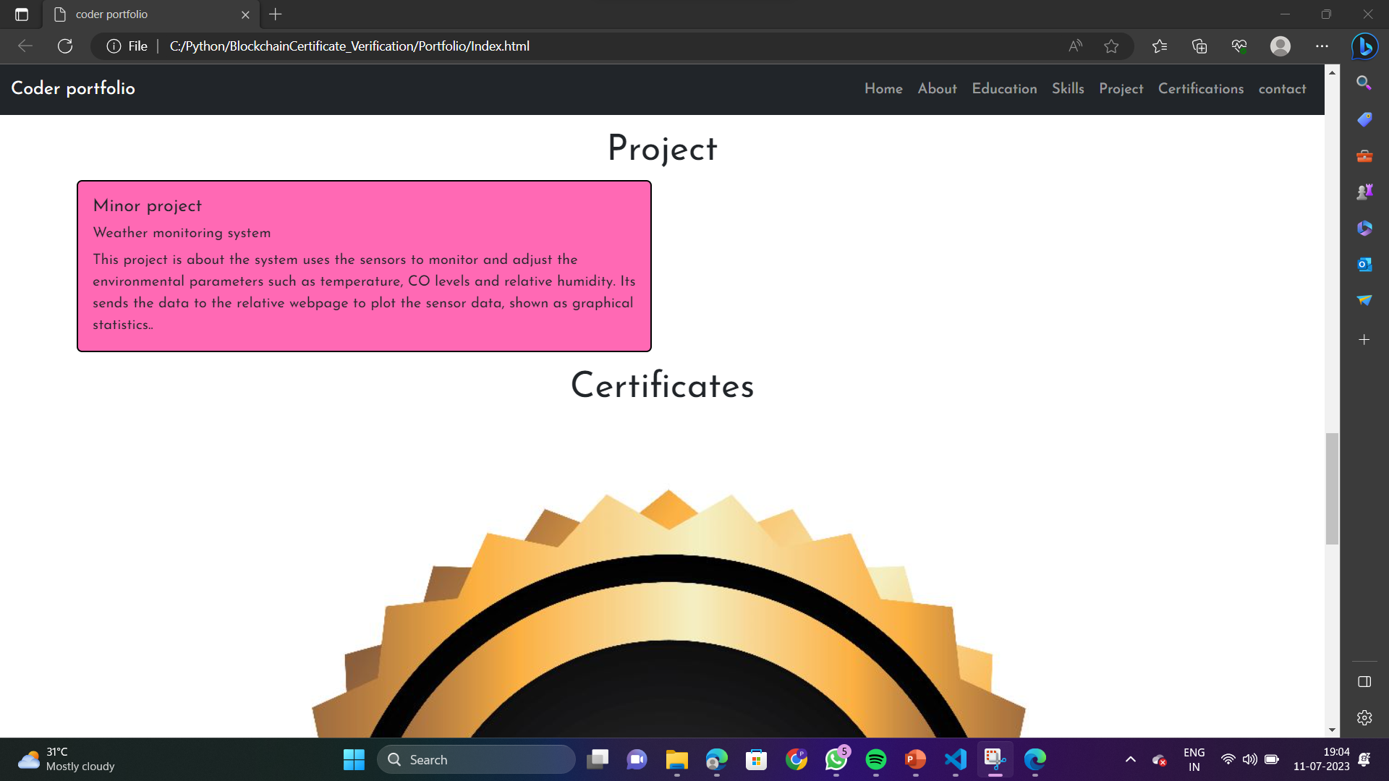
RESULTS
HERE IS THE RESULT FOR THE COMPLETE WEBSITE THAT WE DESIGNED USING DIFFERENT FRONT END LANGUAGES LIKE HTML , CSS & JAVASCRIPT.

Slide 10
LINKS
https://drive.google.com/drive/folders/1vDVWyRt_9l0Q6rEDdBq2lIG2vYU2bEpz?usp=sharing

